Slide 1
AI For software testing

Slide 2
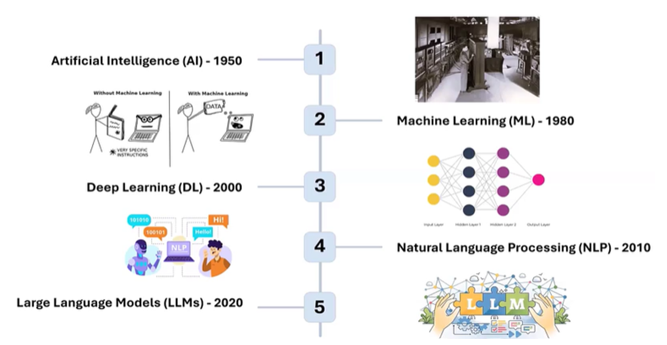

History OF AI

Slide 3
What is AI?
AI, or Artificial Intelligence, is technology that allows computers or machines to think and learn like humans.
It helps them solve problems, answer questions, and do tasks that usually need human intelligence, like recognizing images, understanding speech, or playing games.
In simple words, AI makes machines smart.
Key Characteristics of AI:
Learning: AI improves as it gets more data, just like people get better with practice.
Reasoning: AI uses rules and logic to make decisions.
Problem Solving: It can analyze situations and suggest solutions.
Adaptation: The more it works, the smarter it gets!

Slide 4
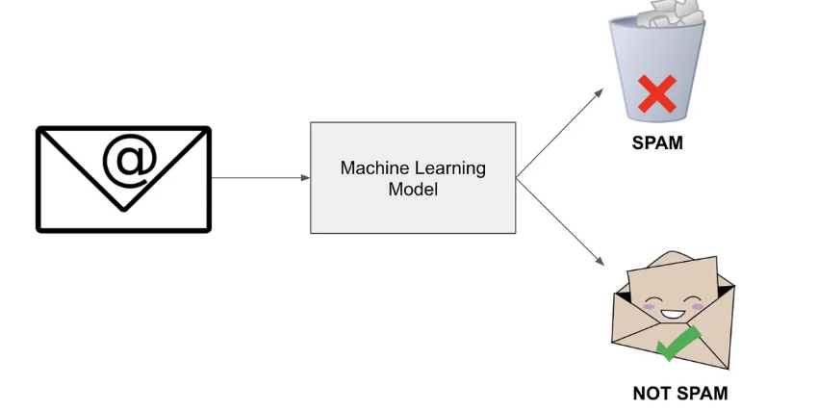
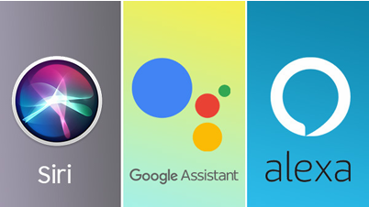


Real World examples
AI in Daily Life:
Gmail spam filter → detects unwanted emails.
Google Translate → converts one language to another.
Amazon/Netflix → recommends movies/products.
Tesla → self-driving car decisions.

Slide 5
LLMs(Large language model)
Large Language Models (LLMs) are a type of AI model trained on massive amounts of text data (books, articles, websites, code, etc.).
They can understand, process, and generate human-like language.
Why “Large”?
Because they are trained on billions or trillions of words.
They have billions of parameters (like memory connections in the brain) that help them predict what word, phrase, or sentence should come next.

Slide 6
What Can LLMs Do?
Text Generation → Write essays, emails, poems.
Summarization → Condense long articles or documents.
Translation → Convert text between languages.
Question Answering → Like ChatGPT answering queries.
Code Generation → Suggest or write programming code.
Reasoning (to some extent) → Solve logic or math step-by-step.
Examples of Popular LLMs
GPT-3 / GPT-4 (OpenAI) → ChatGPT, Claude (Anthropic), Gemini (Google DeepMind), LLaMA (Meta) → Open-source ,Mistral → Lightweight open-source LLM ,DeepSeek → Emerging LLM (China-based)

Slide 7
What is generative ai?
Generative AI is a type of Artificial Intelligence that can create new content (text, images, audio, video, or code) by learning from existing data.
Instead of just analyzing or classifying data, it generates original outputs that look like they were made by humans.

Slide 8
Generative ai models/LLMS
1. Text Generation (LLMs)
These models specialize in generating human-like text, answering questions, summarizing, writing essays, or assisting with code.
ChatGPT (OpenAI) → Conversational AI for text, Q&A, essays, coding.
Google Gemini (formerly Bard) → Multimodal AI (text, image, code).
DeepSeek → Open-source Chinese LLM, gaining popularity for research.
LLaMA (Meta) → Open-source large language models (LLaMA 2 & 3).
GitHub Copilot (powered by OpenAI Codex) → AI pair programmer for code completion.

Slide 9
Generative ai models/LLMS
2. Image Generation
These tools create images, artwork, or designs from text prompts.
DALL·E (OpenAI) → Turns text into creative images and illustrations.
(Other notable ones you can mention if needed: MidJourney, Stable Diffusion)
3. Video Generation
These tools generate or manipulate videos, animations, and short clips. They can even produce realistic videos of people doing or saying things they never actually did.
Runway ML → Text-to-video & video editing.
Pictory → Creates videos automatically from text or scripts.
DeepBrain → Generates talking avatars from text input.
DeepFake Lab → Creates deepfake-style videos.

Slide 10
Generative ai models/LLMS
4. Music Composition
These tools generate original music, beats, or soundtracks based on user input or style.
Jukedeck → AI-generated music for videos.
OpenAI’s MuseNet → Composes music in multiple styles (classical, jazz, pop).

Slide 11
Ai vs generative ai
AI focuses on performing tasks and making decisions based on data, mimicking human behavior (e.g., recognizing images, responding to queries).
Generative AI specializes in creating or generating new content from learned patterns, going beyond decision-making to creativity.
 | AI | Generative AI
Main Use | Understands, analyzes, and acts on data | Creates new content or data
Output | Answers, classifications, recommendations | Text, images, music, code, etc.
Examples | Spam filter, Face ID, voice assistants | ChatGPT, DALL-E, music generators

Slide 12
Why qa should learn GEN AI?
1. Automate Test Case Creation: Generative AI can quickly generate test cases, test scripts, and test data based on requirements. This saves time and helps testers cover more scenarios, including edge cases they might miss manually.
2. Improve Test Coverage: Generative AI can analyze huge amounts of data, learn from past bugs or user behavior, and suggest new areas to test. This leads to better test coverage and higher-quality products.
3. Faster Bug Detection: By automatically generating and running tests, AI can help catch bugs earlier and more efficiently, reducing the time between development and release.
4. Smarter Test Automation: AI tools can adapt to changes in the software (like UI changes) and update tests automatically, making maintenance easier and less time-consuming for testers.
5. Stay Relevant in the Industry: AI is becoming a core part of modern software development and testing. Learning how to use Generative AI keeps QA testers up-to-date and more valuable in their careers.
6. Enhance Reporting and Analysis: Generative AI can help create detailed bug reports, analyze test results, and even summarize findings in clear language, making communication easier between testers and developers.
7.Continuous Learning and Adaptation: Generative AI can help testers learn new testing techniques and approaches by analyzing industry trends and suggesting improvements.

Slide 13
Popular generative ai models
ChatGPT: A text-based AI model that can answer questions, write content, and assist with coding.
Google Gemini: Google’s AI model designed for advanced text generation and problem-solving.
DeepSeek: A generative AI tool focused on creating high-quality text content.
GitHub Copilot: An AI-powered coding assistant that helps developers write code faster and more efficiently.

Slide 14
Prompt Engineering
What is a Prompt?
A prompt is the input or instruction you give to an AI model (like ChatGPT) to tell it what you want.
It can be a question, command, or even a set of guidelines.
Example: “Write 5 positive and 5 negative test cases for login functionality.”
“What is Prompt Engineering?
Prompt engineering is the skill or process of designing and refining prompts to get the best results from an AI model.
It involves experimenting with the wording, structure, and details of your prompts to make the AI give more accurate, helpful, or creative answers.
Instead of asking vaguely → “Write test cases”, You refine: “Generate 10 functional test cases for login with email and password, covering positive, negative, and boundary conditions. Output in table format.”
Why is it important?
Because the quality of the output depends a lot on how you phrase your prompt!

Slide 15
Building components for good prompt
Instruction: What you want the AI to do.
Example: “Summarize this text.”
Context/Background: Information the AI needs to understand your request better.
Example: “This article is about climate change.”
Input Data: The actual data or content you want the AI to work with.
Example: The text, document, or question you provide.
Format/Style Requirements: How you want the answer to be structured or styled.
Example: “Reply in bullet points.” or “Write in simple language.”
Constraints or Examples: Any limits, rules, or examples you want the AI to follow.
Example: “Use less than 100 words.” or “Here’s an example answer…”

Slide 16
Manual Testing with generative ai
Generative AI can be a powerful assistant for manual testers. Instead of replacing manual testing, it helps testers work smarter and faster:
How Generative AI Supports Manual Testing:
Test Case Suggestions: AI can automatically generate new test cases or suggest improvements based on requirements, user stories, or past bugs.
Test Data Creation: AI can quickly create realistic and varied test data (names, addresses, scenarios) so testers don’t have to do it manually.
Bug Reporting Assistance: AI can help draft clear and detailed bug reports, suggest steps to reproduce bugs, or summarize issues for developers.
Exploratory Testing Ideas: AI can provide ideas or checklists for exploratory testing, helping testers think of edge cases or unusual user paths.
Documentation Help: AI can help write or organize test documentation, summaries, and checklists.

Slide 17
1. Creating a Test Plan
Prompt:
"Generate a detailed test plan for a [web/mobile] application for [domain: e-commerce, banking, healthcare, etc.]. Include test objectives, scope, test strategy, test environment, risks, and assumptions.”
Example:
"Create a test plan for an online e-commerce website that includes test scope, test objectives, entry/exit criteria, testing tools, test schedule, and risk mitigation."

Slide 18
2. Writing Test Scenarios & Test Cases
Prompt:
"Generate functional test scenarios and test cases for a [feature/module] of a [web/mobile] application. Use techniques like Equivalence Class Partitioning (ECP) and Boundary Value Analysis (BVA) where applicable.“
Example:
"Write test cases for the login functionality of a banking application using BVA and ECP. Include positive and negative test cases.“
Additional Prompt for Edge Cases: "Provide edge case test scenarios for a [feature/module] of a [web/mobile] application.“
Example: "Give edge case test scenarios for an online payment gateway."

Slide 19
3. Creating Test Data
Prompt:
"Generate valid and invalid test data for testing a [feature/module]. Consider scenarios for edge cases, negative testing, and boundary conditions.”
Example:
"Generate test data for an e-commerce checkout process, including valid and invalid credit card numbers, discount codes, and shipping addresses."

Slide 20
4. Writing a Bug Report
Prompt:
"Write a bug report for a defect found in [feature/module] of a [web/mobile] application. Include steps to reproduce, expected vs. actual results, severity, priority, and screenshots (if applicable).”
Example:
"Generate a bug report for an issue where users cannot reset their password on an e-commerce website. The reset email is not sent after clicking 'Forgot Password'."

Slide 21
5. Generating Test Summary Report
Prompt:
"Create a test summary report for a completed testing phase of a [web/mobile] application. Include executed test cases, pass/fail rates, defects found, and recommendations.“
Example:
"Generate a test summary report for the regression testing phase of an online banking app, including defect statistics and unresolved issues."

Slide 22
Generative ai in API Testing

Slide 23
Api testing
1)Creating Payload Prompt:
Generate a JSON payload for creating a new user in an API.
The payload should contain f ields like id, name, email, age, and address with sample values.
2) Creating POJO (Plain Old Java Object) Class from JSON:
3)Add Assertions for the API Response Prompt:
4)Write assertions using RestAssured and TestNG for the following API response:
{ "status": "success", "message": "User created successfully", "userId": 101 }
Validate that:
● The status code is 201.
● The status field is "success".
● The userId is an integer."

Slide 24
API Testing
5) Convert JSON to CSV Prompt: Write a Java utility to convert the following JSON array to a CSV file:
[ { "id": 1, "name": "Alice", "email": "alice@example.com" }, { "id": 2, "name": "Bob", "email": "bob@example.com" } ]
6) Convert CSV to JSON Prompt:
Write a Java program to read a CSV file containing columns id, name, and email, and convert it into a JSON array.
7) Creating Utility to Read Data from JSON File Prompt:
Write a Java utility to read data from a JSON file and return it as a Java object using Jackson. Assume the JSON contains a list of users with id, name, and email fields.
8) Creating Utility to Read Data from CSV File Prompt:
Write a Java utility to read a CSV file containing id, name, and email fields and return a list of Java objects.

Slide 25
Generative ai in Selenium

Slide 26
Key Benefits of Using Generative AI in Selenium
Generative AI can enhance productivity in Selenium web automation by assisting with various tasks, including:
● Generating Test Scripts: Automates the creation of test scripts.
● Debugging Selenium Errors: Identifies and resolves errors effectively.
● Writing XPath and CSS Selectors: Crafts optimized and maintainable locators.
● Creating Test Data: Generates realistic test data for automation.
● Automating Test Case Writing: Simplifies test case design.
● Generating Reports: Produces detailed test execution reports.

Slide 27
Generative AI in Selenium
1. Writing Selenium Test Scripts
Prompt:
"Write a Selenium WebDriver test script in Java using TestNG to validate the
login functionality of a web application. Use the Page Object Model."
2. Generating XPath & CSS Selectors
Prompt:
"Generate an optimal XPath and CSS selector for a login button with the
following HTML:
<button id='loginBtn' class='btn primary'
type='submit'>Login</button>
Use best practices for maintainability."

Slide 28
Generative AI in Selenium
3. Debugging Selenium Errors
Prompt:
"I am getting the following Selenium error:
org.openqa.selenium.NoSuchElementException: Unable to
locate element
Here is my code snippet:
driver.findElement(By.id("loginBtn")).click();
How can I fix this issue?"

Slide 29
Generative AI in Selenium
5. Writing Assertions for Selenium Tests
Prompt:
"Write assertions in TestNG using the Assert class to verify that after a
successful login, the URL contains 'dashboard' and a welcome message is
displayed."
6. Generating Test Data (Using Faker Library)
Prompt:
"Generate random test data for user registration, including name, email,
phone number, and address, using the Java Faker library in Selenium
automation."

Slide 30
Limitation of llms
Lack of Real-Time Knowledge: LLMs are trained on data up to a certain point and cannot access real-time or updated information.
For example: ChatGPT (as of 2023 data) won’t know about events in 2025.
Asking an LLM about a recently released software tool might result in outdated details.
No Contextual Memory: LLMs don’t retain memory of past interactions. Each query is treated independently.
Inability to Perform Actions: LLMs can generate text but cannot perform tasks like booking a flight or sending an email.
Bias and Inaccuracy: LLMs may produce biased or incorrect outputs based on their training data.
Limited Understanding: LLMs can't truly understand context like humans. They generate responses based on patterns, not actual comprehension.

Slide 31
AI Agent
An AI agent is a system that uses artificial intelligence to perform tasks autonomously.
It can perceive its environment, make decisions, and take actions to achieve specific goals.
AI agents often combine LLMs with other tools, APIs, and decision-making algorithms.
Key Features:
Autonomy: Can operate without constant human intervention.
Adaptability: Learns and improves over time.
Goal-Oriented: Designed to achieve specific objectives.
Examples:
A customer support AI agent can answer queries, resolve issues, and escalate problems to human agents if needed.
A chatbot that not only responds to user queries but also books a ticket for a flight, considering available options, user preferences, and payment details.

Slide 32
Ai agent examples
ChatGPT / Copilot → Helps generate answers, code, or test cases.
Selenium + AI Agent → Could decide which test cases to run automatically.
Personal Assistant AI (Alexa, Siri, Google Assistant) → Handles reminders, searches, smart home devices.
Game AI → NPCs (non-player characters) that adapt to player strategies.
Robotics AI Agent → A robot vacuum that maps and cleans your house.

Slide 33
Ai power tool TestRigor
testRigor is an AI-powered, no-code test automation platform designed to streamline the process of creating and maintaining end-to-end tests for web, mobile, desktop, and API applications.
Unlike traditional tools that require coding expertise, testRigor enables teams to write tests using natural language, making automation accessible to both technical and non-technical users.
https://testrigor.com/

Slide 34
GitHub copilot
Github Copilot is your AI-powered companion created by Microsoft to help you think, create, and get things done more efficiently—whether you're working, studying, or just exploring ideas.
It’s available across platforms like Windows, macOS, iOS, Android, and the web, and it’s deeply integrated into Microsoft apps like Word, Excel, PowerPoint, and Teams.
It can complete functions, suggest whole code blocks, and even generate new code based on comments.
GitHub Copilot = Your AI pair programmer that helps you generate, complete, and improve code quickly.
Where You Can Use GitHub Copilot
VS Code (most common)
IntelliJ / PyCharm / WebStorm/Eclipse
GitHub.com directly in the browser editor

Slide 35
advantages
● Saves Time: Quickly suggests code, reducing typing work.
● Boosts Productivity: Helps you focus on logic instead of syntax.
● Works in Real-Time: Gives suggestions directly inside your editor.
● Supports Multiple Languages: Works with Python, Java, JavaScript, C#, etc.
● Helpful for Beginners: Shows example code directly, so learners can understand faster.
● Can Learn From Comments: Write a comment, and Copilot generates the code for it.

Slide 36
Copilot setup in vs code
Download & install Visual Studio Code.
Install Extensions:
Java Extension Pack (for Java projects).
Maven for Java (if you’re using Maven).
GitHub Copilot (from Marketplace).
GitHub Copilot Chat (optional, for asking Copilot questions).
Login to GitHub account inside VS Code → enable Copilot.

Slide 37
Model Context Protocol (MCP) framework
MCP is an open protocol that designed to allow large language models(LLMs) to interact with software tools-like browsers using structured machine-readable data.
MCP provides a standardized way to connect AI models to different data sources and tools.
MCP enables you to build agents and complex workflows on top of LLMs and connects your models with the world.
MCP provides:
A growing list of pre-built integrations that your LLM can directly plug into
A standardized way to build custom integrations for AI applications
An open protocol that everyone is free to implement and use
The flexibility to change between different apps and take your context with you

Slide 38
Model Context Protocol (MCP) framework
The Model Context Protocol (MCP) framework incorporates various components that interact with each other and leverage existing network protocols such as TCP, NFS, and HTTPS.
MCP Host, Client, and Server
MCP Host: The MCP host typically refers to the environment or platform where MCP is deployed and operates. The host is responsible for facilitating the interaction between MCP clients and MCP servers.(eclipse,vscode etc)
MCP Client: An MCP client is an entity, such as an application or agent, that utilizes the capabilities exposed by MCP servers. MCP clients request to perform specific actions or gather data by invoking APIs hosted on MCP servers.
MCP Server: MCP servers host the APIs that expose their capabilities in a configuration that MCP clients can discover and invoke. These servers provide a standardized interface for clients to interact with various services or perform actions.

Slide 39
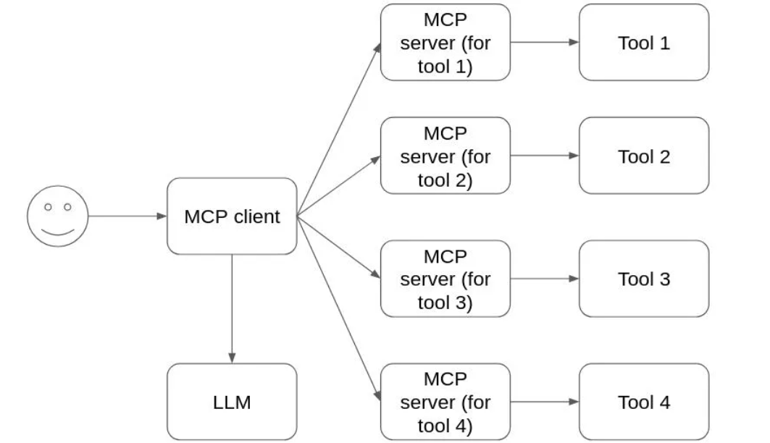
Model Context Protocol (MCP) framework
MCP does not directly connect LLMs with tools.
The MCP client component accesses the LLM, and the MCP server component accesses the tools.
One MCP client has access to one or more MCP servers. Users may connect any number of MCP servers to an MCP client.

Slide 40
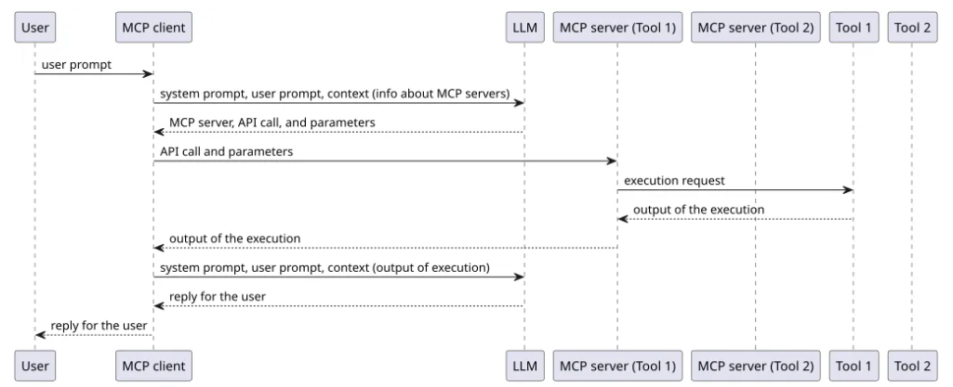

Slide 41
Model Context Protocol (MCP) framework
Here's what a typical MCP client and server exchange looks like:
The user requests a task from the MCP client
The MCP client has the information about the tools that each MCP server implements or has access to
The MCP client passes the request from the user plus the information from the MCP servers to an LLM which responds with the tool needed and the parameters to be used
The MCP client sends the information about the tools and parameters to the MCP server
The MCP server completes the task and returns the answer to the MCP client that passes the answer to the LLM, and the LLM generates a response for the user
The response is shown to the user by the MCP client

Slide 42
Model Context Protocol (MCP) framework
MCP servers can be run locally or remotely, and the security risks differ depending on how they are executed.
We define "local MCP servers" as the MCP servers that we run in a host that we control.
To perform the requested tasks, local MCP servers usually execute OS commands or custom code locally.
"Remote MCP servers" are only run remotely by a third party.
We can have access to remote MCP servers, but they don’t run on a host we control.
Remote MCP servers still have security risks for the users because they have access to their data, but since they are not executed locally, many common risks don’t apply.

